Slide 1


Slide 2

Cloud battles: Choosing Azure, AWS or Google battleships
Viktorija Almazova
Cloudworks

Slide 3


Slide 4
2006
AWS invented Cloud market
Started with EC2 and S3
by 2009 it was mostly used by startups
As IaaS starter
Netflix, Airbnb, BMW, Spotify, British Gas, Dow Jones, Kellog’s

Slide 5
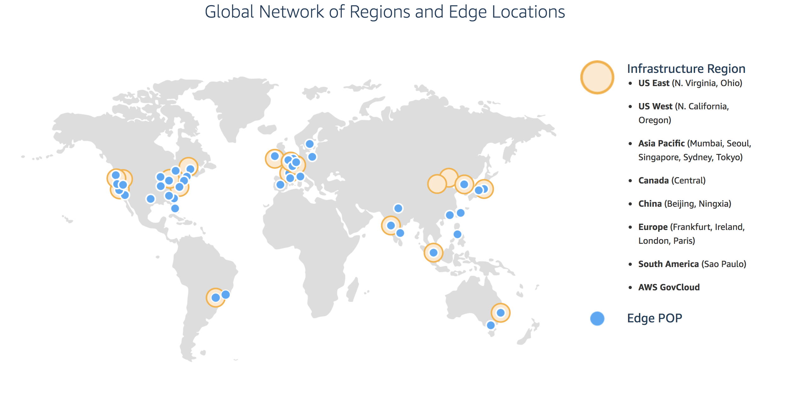

Slide 6
Amazon's biggest strength is its dominance of the public cloud market
Amazon’s infrastructure is enormous
AWS has a huge and growing array of available services

Slide 7
2010
Started as PaaS
Choice for Corporates
Hybrid connection
MS products
Pixar, Maersk, Hershey, Boeing

Slide 8
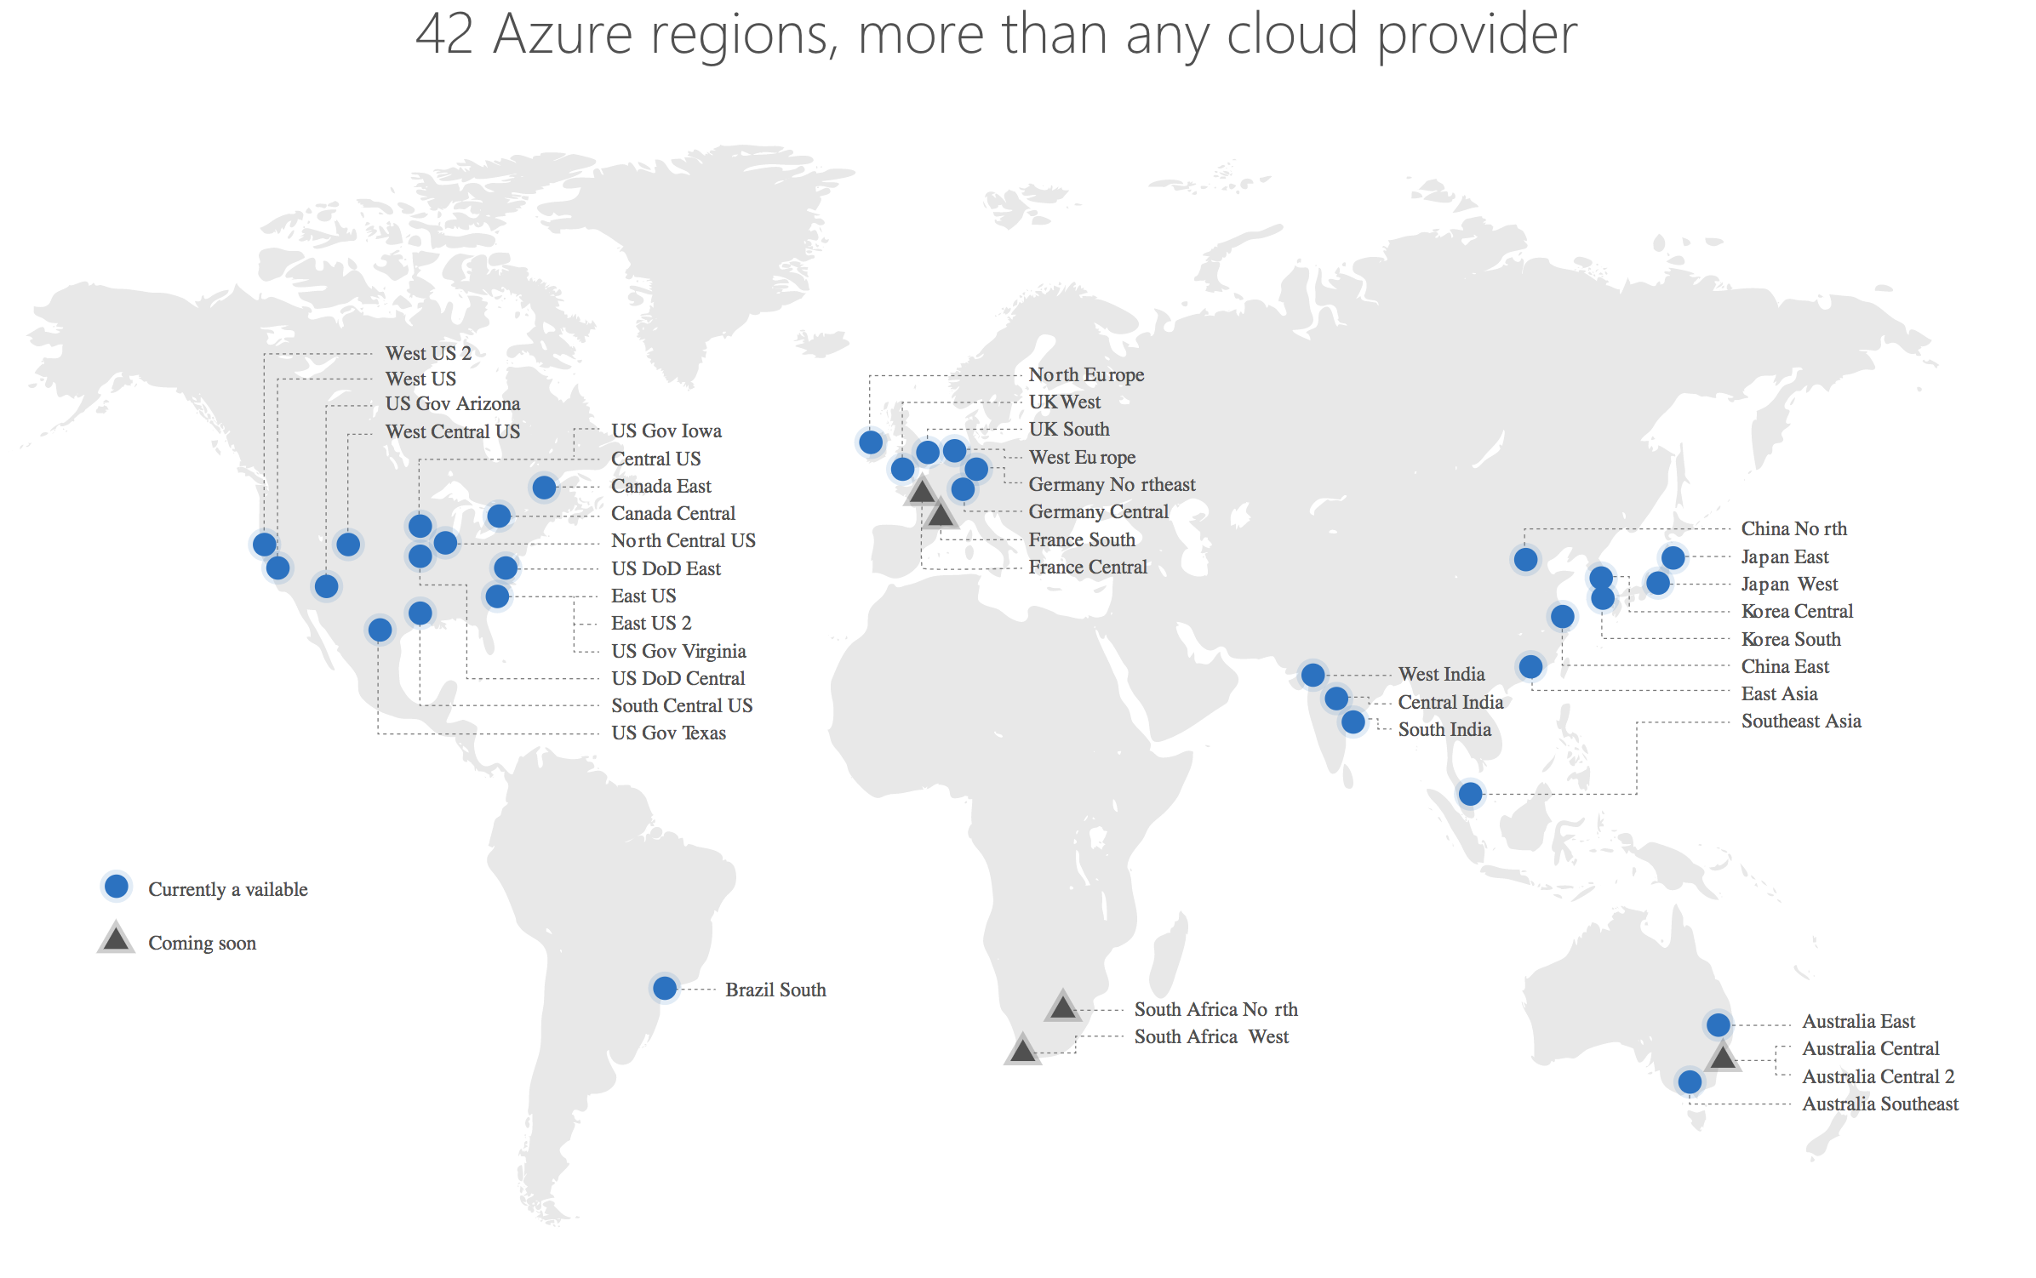

Slide 9
Microsoft is frequently chosen as a strategic cloud provider by customers that are committed to Microsoft technologies
support for hybrid cloud environments, including its Azure Stack software
embrace of Linux and other open source technologies has also helped attract some enterprises

Slide 10
2008
Started with Google App Engine
Different approach comparing with AWS and Azure
GANT, Lush, HSBS, M&S

Slide 11
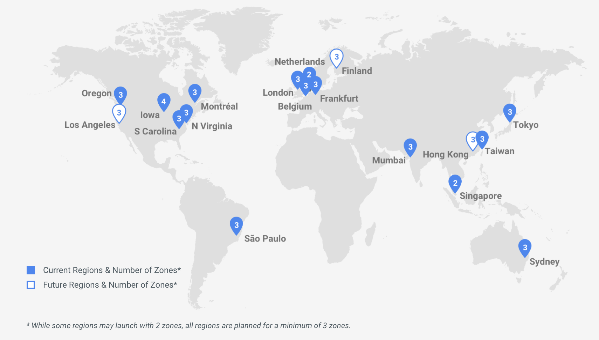

Slide 12
GCP is most attractive to cloud-native companies and those that want to 'run like Google.’
It has a strong offering in containers, since Google developed the Kubernetes standard that AWS and Azure now offer
GCP specializes in high compute offerings like Big Data, analytics and machine learning

Slide 13
Compute
EC2
EC2 Auto Scaling
Elastic Container Service
EKS
Elastic Container Registry
Lightsail
Batch
Elastic Beanstalk
Fargate
Lambda
Serverless Application Repository
VMware Cloud
Virtual Machines
Virtual Machine Scale Sets
App Service
Functions
Azure Container Service
Container Instances
Container Registry
Service Fabric
App Service
Batch
Compute Engines
Kubernetes
App Engine
Cloud Functions

Slide 14
Storage
S3
EBS
Elastic File System
Glacier
Storage Gateway
Snowball
Snowball Edge
Snowmobile
Storage
Blob Storage
Archive Storage
Queue Storage
File Storage
Disk Storage
Data Lake Storage
StorSimple
Backup
Site Recovery
Cloud Storage
Persistent Disk
Google Transfer Appliance
Cloud Storage Transfer Service
BigQuery Data Transfer Service

Slide 15
Database
Aurora
RDS
DynamoDB
ElastiCache
Redshift
Neptune
DB Migration Service
SQL Database
Database for MySQL
Database for PostgreSQL
SQL Data Warehouse
SQL Server Stretch Database
Cosmos DB
Redis Cache
Azure Database Migration Service
Cloud SQL
Cloud BigTable
Cloud Spanner
Cloud Datastore

Slide 16
Networking
Amazon VPC
Amazon CloudFront
Amazon Route 53
Amazon API Gateway
Elastic Load Balancing
AWS Direct Connect
Virtual Network
Content Delivery Network
Azure DNS
Application Gateway
VPN Gateway
Load Balancer
Traffic Manager
ExpressRoute
Network Watcher
VPC
Cloud Load Balancing
Cloud CDN
Cloud DNS
Cloud Interconnect
Network Service Tiers

Slide 17
Security & Identity
IAM
Organizations
SSO
Cloud Directory
Directory Service
Cognito
GuardDuty
Inspector
Macie
Certificate Manager
CloudHSM
Key Management Service
Shield
WAF
AAD
AAD Identity Protection
AAD B2C
AAD Domain Services
Application Proxy
Security Center
Key Vault
Azure DDoS Protection
Cloud IAM
Cloud Identity Aware
Proxy
Cloud Data Loss
Prevention API
Security Key Enforcement
Cloud Key Management Service
Cloud Security Scanner

Slide 18
Management Tools
CloudWatch
CloudTrail
Config
OpsWorks
Personal Health Dashboard
System Manager
Trusted Advisor
Azure Advisor
Application Insights
Log Analytics
Azure Monitor
Network Watcher
Google Stackdriver
Monitoring
Logging
Error reporting
Trace
Debugger
Cloud Management

Slide 19
ML & AI
SageMaker
Comprehend
Lex
Polly
Rekognition
Machine Learning
Translate
Transcribe
DeepLens
Deep Learning AMIs
Apache MXNet
TensorFlow
Machine Learning Services
Machine Learning Studio
Azure Bot Service
Cognitive Service
Computer Vision API
Face API
Content Moderator
Emotion API
Video Indexer
Various Speeches API
LUIS
Text Analytics API
Translator Text API
Recommendations API
Bing APIs
Microsoft Genomics
Cloud AutoML
Cloud ML Engine
DialogFlow Enterprise
Cloud Natural Language
Cloud Speech API
Cloud Translation API
Cloud Vision API
Cloud Video Intellegence

Slide 20
Dev Tools
Console
CLI
CloudFormation
API
CodeStar
CodeDeploy
X-Ray
CodeCommit
CodePipeline
CodeBuild
Cloud9
Azure portal
Cli
Cloud Shell
Azure Resource Manager
API
VSTS
Visual Studio App Center
Azure DevTest Labs
App Insights
Cloud Console
Cloud Shell
API
Container Registry
Container Builder
Cloud Source Repositories
Cloud Tools for IntelliJ
Cloud Test Lab

Slide 21
Various
MQ/SQS
WorkSpaces
AppStream 2.0
IoT Core
FreeRTOS
Greengrass
IoT Device Management
GameLift
Lumberyard
Logic Apps
Noitification Hubs
Event Hubs
IoT Hub
IoT Edge
BigQuery
Cloud Dataflow
DataProc
Datalab
Dataprep
Genomics
Cloud IoT Core

Slide 22
Cloud pricing
Prices go down
Discounting options increase
Per second billing

Slide 23
What to choose?

Slide 24
Resources
Slides and demos from the conference will be available at github.com/nordicinfrastructureconference/2018 (bit.ly/2y7JhA3)

